Slide 1
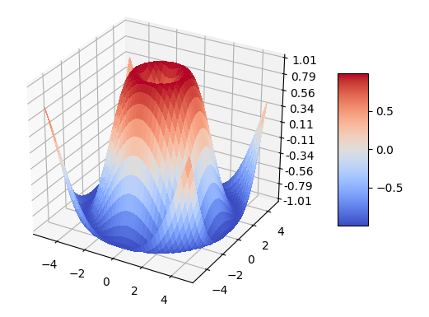
Maths, graphs, and all things holy

Slide 2
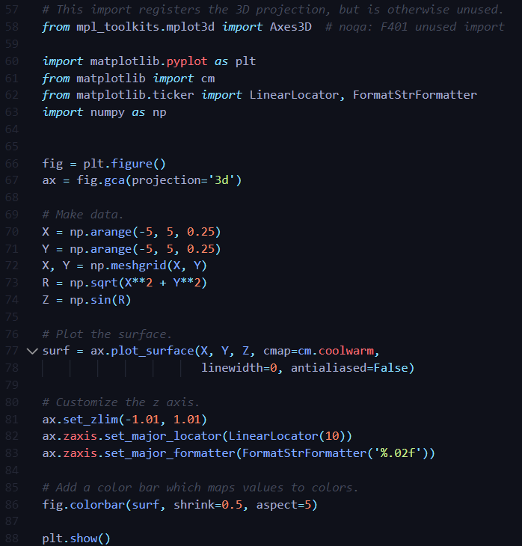
Today you’ll learn how to make this bad boy… and more!

Slide 3
Why should I teach mathing and graphing and whatnot?
Data is the new oil, and you need “maths” to deal with it.

Slide 4
Why should I teach mathing and graphing and whatnot?
You probably already know why graphs are useful.

Slide 5
Why should I teach mathing and graphing and whatnot?
Maths and graphs allow you to pull off game-changing things.

Slide 6
How is it useful?
Working out how similar one thing is to another
Figuring out the relationship between two things (how one thing affects another)
Simulating physics
Orbiting planets (centripetal force)
Gravity (gravitational attraction)
Objects hitting each other (Collision)

Slide 7
Functions? Like a robot’s minigun?
You’ve probably seen functions in previous sessions so far, but how can you make use of them?

Slide 8
Functions? Like a robot’s minigun?
If you remember Maths, you would have some cheesecake like (sorry mathematicians, I don’t mean it):
f(x) = 3x + 2

Slide 9

Functions? Like a robot’s minigun?
If you remember Maths, you would have some cheesecake like (sorry mathematicians, I don’t mean it)…
f(x) = 3x + 2
Here’s how you easily express it in code…

Slide 10
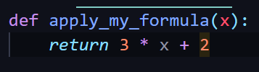
Functions? Like a robot’s minigun?
On a side note:
Please never call your functions ‘f’.
This doesn’t mean anything to you or me.
A better function name could be…
Note how the function name starts with a verb. This is very good practice.

Slide 11
While we’re in the lovely world of maths…
You’ll find many things in Python are literally what you expect them to be. Going with your intuition is generally a good idea.
max(3, 6)
6
min(3, 6)
3
import math
math.sqrt(16)
4

Slide 12
These functions aren’t really magic…
You’ll be using a lot of stuff in Python that appears to do ridiculous things.
There’s definitely typically a lot of code behind them… But really, you’re doing exactly what they’re doing!

Slide 13
These functions aren’t really magic…
def min2(*args):
lowest = None
for arg in args:
if lowest is None or arg < lowest:
lowest = arg
return lowest
example_1 = min(1, 4, 3, -5, 3)
print(example_1)
example_2 = min2(1, 4, 3, -5, 3)
print(example_2)
-5
-5

Slide 14
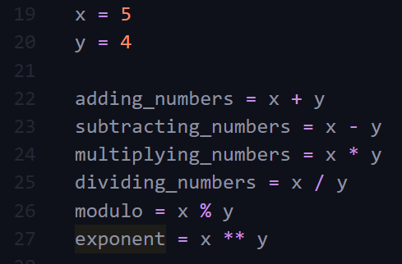
Arithmetic Operations?
Again, Python’s very intuitive. E.g.
9
1
20
1.25
1
625

Slide 15
Alright, so let’s dive into something really useful.
You’ll need to confidently use functions and operators together to do cool stuff.
These are the building blocks for the next part…
Vectors and Matrices

Slide 16
Vector Nectar
Vectors scared me when I first learnt them, but to be honest, they’re actually really simple and incredibly useful.
To humanize the thing, imagine the scenario where you have a graph. You have Xs and Ys…

Slide 17
Vector Nectar
X (Attendance) | 20 | 60 | 20 | 90 | 95
Y (Exam Performance) | 85 | 40 | 90 | 80 | 75

Slide 18
Vector Nectar
X (Attendance) | 20 | 60 | 20 | 90 | 95
Y (Exam Performance) | 85 | 40 | 90 | 80 | 75
[ ]
20
85
Surprise! It’s a vector!

Slide 19
Vector Nectar
Vectors aren’t just about marking attendance and exam performance…
You can extend this for any groups of data, of course!
e.g. Literally anything you use graphs for,
Representing coordinates,
Physics
Statistics

Slide 20
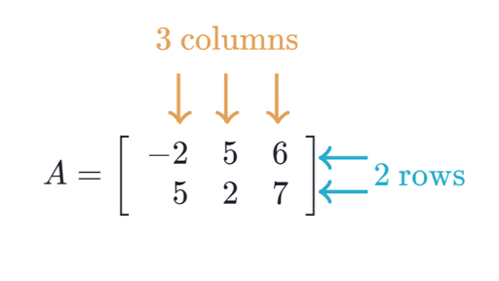
What’s this matrix malarkey then?
I introduced vectors first because guess what…
Matrices are literally just a group of vectors!!!

Slide 21
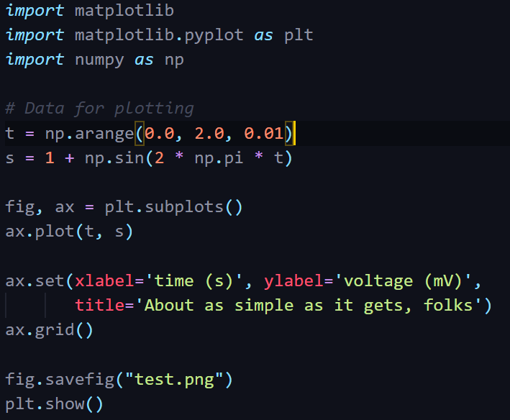
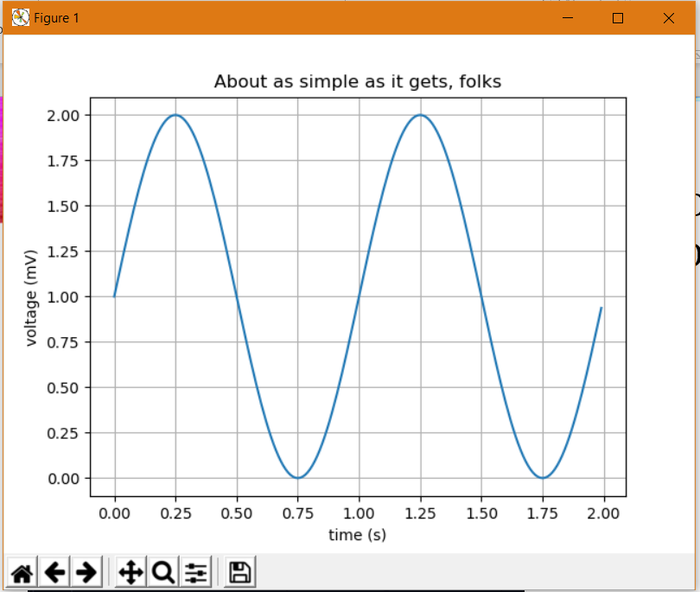
Okay so this is cool (I hope), but how does this apply to coding?
SRC: https://matplotlib.org/gallery/lines_bars_and_markers/simple_plot.html#sphx-glr-gallery-lines-bars-and-markers-simple-plot-py

Slide 22
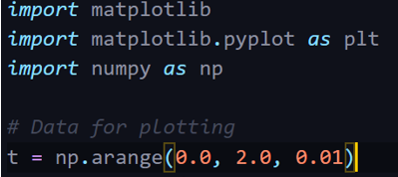

Sorry for the heart attack of code. Let’s break it down.
Adding a plotting library and
its plotting module!
Numpy is a vector/matrix
library!
Imagine this is just like the attendance X values from
earlier… just a lot smaller than that…

Slide 23
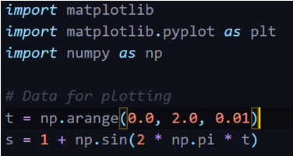
This is where it gets a bit funky…
So arange generates, you guessed it, a range of numbers between 2 numbers…
But what on Earth is going on with np.sin(…)?!

Slide 24
All together now…
While the additional parts may seem verbose, they’re at least:
self-describing
And you don’t really need to “remember” them as such.
Running this program gives us…

Slide 26
The Takeaway
The main things to take away here is:
How the data was stored
How it was manipulated
How it was inserted into the graph
You don’t need to remember all of the code, just the general process.
Looking things up is 60% of a coder’s job! StackOverflow is someone I would marry if it were a person. (Though I’m sure it would be slightly odd.)

Slide 27
Right, so where do we go from here?
Surprise theme change! Owooooooooooooo-
Knowing how an example works is great and all, but that’s not really, properly, actionable for you.
It’s time to turn things up a notch…

Slide 28
Getting Serious
First of all, that np.sin(…) business isn’t normally how useful data is graphed. We take real world data and graph it. We don’t just graph random numbers.
However, the tricks with regard to 2 * np.pi * t and the 1 + will be extremely useful to us.
In fact it’s not even just those parts, it’s that entire line.

Slide 29
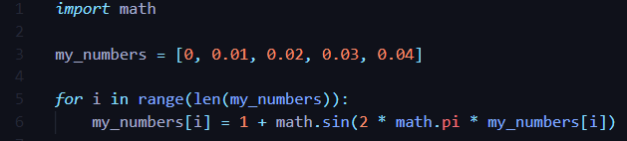
Getting Serious
In fact this is so important that I need to really emphasise a point here.
That np.sin(…) business is just straight up BANANAS. Why?
To do the same thing with the good old lists that you already know, I’d have to do something like this.

Slide 30
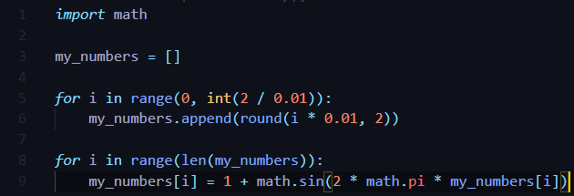
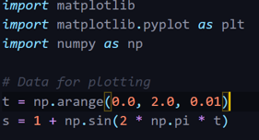
This is why you had to learn matrices.

Slide 31
Whenever dealing with matrices and vectors, always use the numpy (np) library.
Life is painful when you ignore it.

Slide 32
You’ll combine some skills.
You’ve learnt how to open files in Python. This is no coincidence…
A lot of valuable data is often stored in files, for obvious reasons. Say… take an Excel spreadsheet for instance.
We’ll need that data to do cool things. You’ll be re-introduced with your friend, input/output in the workshop today.

Slide 33
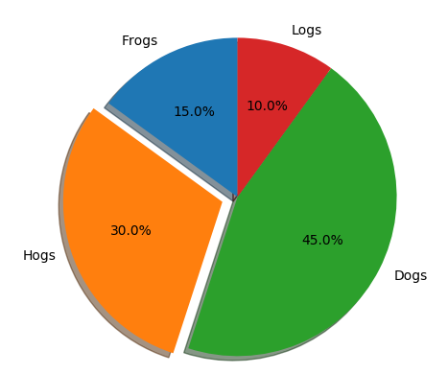
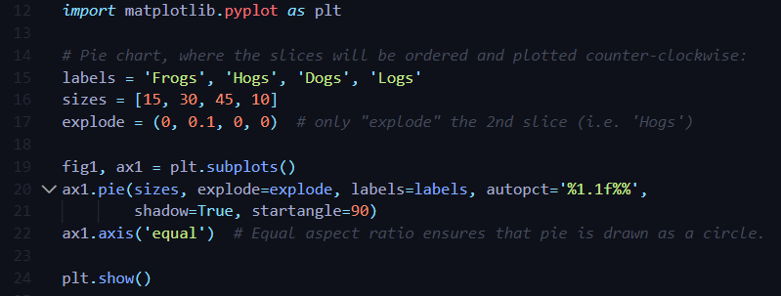
We are now serious

Slide 34
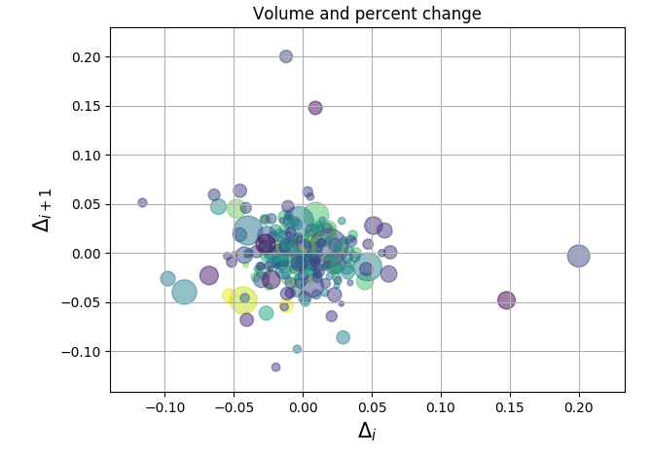
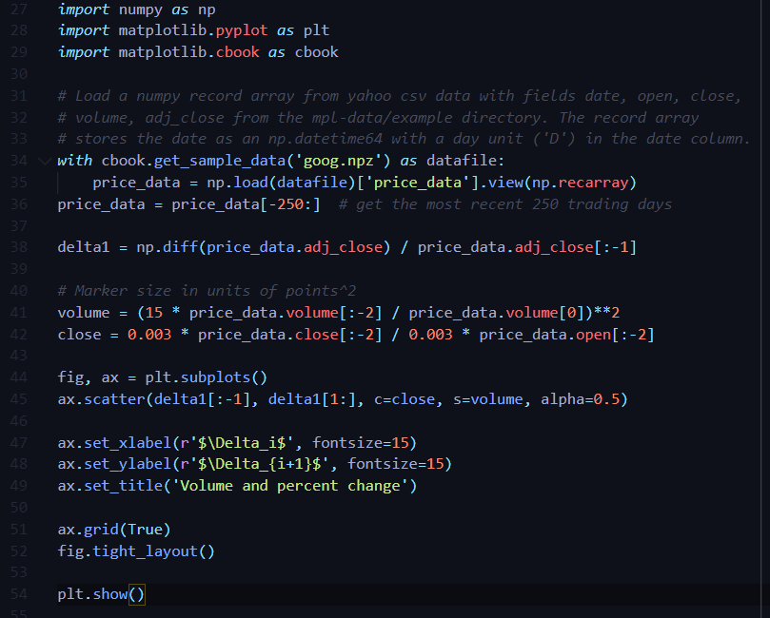
We are now more serious…

Slide 35
We are deadly serious!

Slide 36
As you can see, you really are not limited at all.
There is some bloody cool stuff out there you can try out, but most importantly…
It’s not actually that hard. Each one has similarities.
The big takeaway here? If something feels hard, it’s because you haven’t broken it down yet.

Slide 37
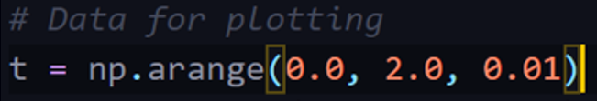
Over to you!
Guidelines for the workshop and key takeaways from this presentation:
Create your own functions to make plotting your data clean, easy and readable.
Obtain and manage your data with the use of matrices, with help from the numpy library.
Always use the numpy library to manipulate matrices.
Experiment with all kinds of graphs, don’t be afraid to look things up and try. Google “matplotlib” for a reference, and to also to find more graph types.
Functions are an example of a extremely important programming philosophy called problem decomposition. Things may look hard at first, until you break them down into steps and attempt them!

